Slide 1
The AfCTA – Opportunities and Realities
Matthew Stern
11 March 2021

Slide 2
Structure of Presentation
South Africa’s trade with Africa
The potential contribution of the AfCFTA
Some practical realities

Slide 3
South Africa’s Trade with Africa

Slide 4
South Africa’s exports by major trading partner

Slide 5
South Africa’s exports to Africa – by sector
Notes:
More than 50% of finished and intermediate exports go to Africa

Slide 6
South Africa’s exports to Africa – by region
Notes:
Just six countries, make up close to 70% of total exports to Africa

Slide 7
The potential contribution of the AfCFTA
Notes:
So for SA, the AfCFTA potentially opens up a much larger market for SA exports. But what does the AfCFTA offer for the rest of the continent.

Slide 8


The structure of trade
US$ 471 bn
US$ 78 bn
US$ 568 bn

Slide 9
Intra-regional exports / total exports (2019)

Slide 10
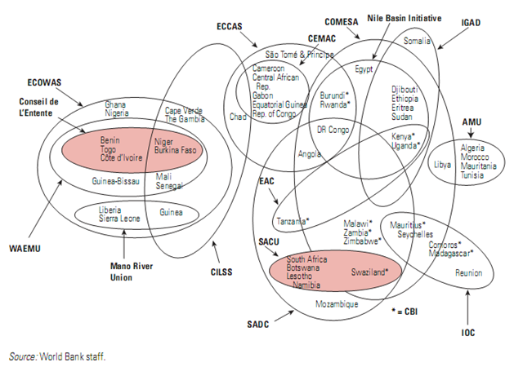
The great African spaghetti bowl
Notes:
There have been multiple efforts to raise intra-regional trade through preferential arrangements: free trade areas, customs unions and various other initiatives.
Makes trade across the continent complicated and costly

Slide 11
The great African egg basket
AFCFTA
ECCAS
IGAD
ECOWAS
COMESA
CENSAD
AMU
SADC
EAC
Notes:
Framework agreement that encompasses the 8 main regional economic communities; and facilitates trade between them

Slide 12



The great African customs union
55 countries
1.3 billion people
US$2.6 trillion in GDP
Notes:
These regional communities, and the AfCFTA, are seen as a building block towards the establishment of a large African-wide customs union

Slide 13
The size of the gains
Intra-African trade could increase by between 33% and 52% (as much as US$35 bn)
  From 10% to 15% of total trade by 2022
  Rising further to 22% of total trade if accompanied by trade facilitation reforms
Intra-African trade in services could rise by 31.9 per cent
African GDP could increase by between 0.2% and 1%
Total employment could increase by as much as 1.2%
The distribution of these benefits differs by country
  One study suggests that smaller and more protected countries will gain most
  Others show that larger economies such as South Africa, Angola, Nigeria, and Kenya are likely to capture greater benefits
If specific products are exempted from the agreement, the total gains would be much less
Revenue losses are likely to be modest and can be managed through exclusions
Notes:
15 studies identified and reviewed

Slide 14
Some practical realities
Notes:
This is a remarkably ambitious initiative. Whereas the agreement came into effect on 1 January 2021, there is still some hard work to be done to ensure that it works and delivers on its potential.

Slide 15
Implementation modalities
Ratification and implementation
  As of 29 January 2021 (SARS):
    34 countries had ratified the agreement
    41 tariff offers submitted; but in most cases not yet legislated
    Two countries (Egypt and Sao Tome) qualify for preferences in South Africa, and vice versa (SARS)
SA tariff offer
  Currently 81% of tariff lines
  Subject to reciprocity in terms of coverage and phase-down period
Notes:
Much will of course depend on how the agreement is structured, implemented and enforced
SA will only provide preferences to countries that offer something that is equally good. This raises questions around what the final configuaration of the agreement will look like.

Slide 16
Re-scrambling the spaghetti bowl
E.g. South Africa’s possible tariff regimes for goods within the AfCTA
Simplest negotiation scenario
Preferential tariff regimes for imports into South Africa
Preferential tariff regimes for exports from South Africa
SADC
Tripartite
COMESA
EAC
ECCAS
ECOWAS
SADC
Rest of Africa
Algeria
Mauritania
Morocco
Saharawi ADR
South Africa makes a single tariff concession offer to all countries not part of SADC.
EAC, ECCAS, ECOWAS and COMESA negotiate as customs unions.
Most complex negotiation scenario
EAC
Mauritania
Sao Tome and Principe
Tunisia
Libya
ECOWAS
Morocco
Egypt
Djibouti
Algeria
CEMAC
Saharawi ADR
South Sudan
Ethiopia
South Africa agrees a different tariff schedule with each country not part of SADC.
EAC, ECOWAS and CEMAC negotiate as customs unions.
SADC
Somalia
Togo
Eritrea
Notes:
Worst case, SA will end up negotiating 17 different bilateral agreements with various countries and customs unions in Africa

Slide 17
The power of exclusions (% of trade impacted by sensitive lists)
Notes:
Members must phase out 90% of tariff lines over the next five to 10 years. Another 7% considered sensitive will get more time, while 3% will be allowed to be placed on an exclusion list.
Even with an exclusion list of 1% of its tariff lines, this country could continue to charge tariffs on around 40% of all goods exported by other AfCFTA member countries

Slide 18




Rules of origin
“Under the African Continental Free Trade Area, it is the rules of origin – establishing the nationality of products produced in Africa – that will determine whether preferential trade liberalization can be a game changer for Africa’s industrialization”
Mukhisa Kituyi; Secretary-General of UNCTAD)
Coffee, tea and spices:
  All Materials of this Chapter used must be wholly obtained
A blend of premium Colombian, Costa Rican and Ethiopian beans. An intense, yet well-balanced Italian-style blend, with a sweet, nutty finish.
Our CBD-infused Ethiopian and Kenyan espresso blend is the perfect mix of two African darlings. We delicately roast spicy and sweet floral aromas to produce a full-bodied experience that is perfect for any coffee lover.
Notes:
RoO in the AfFCTA are product specific and relative restrictive

Slide 19
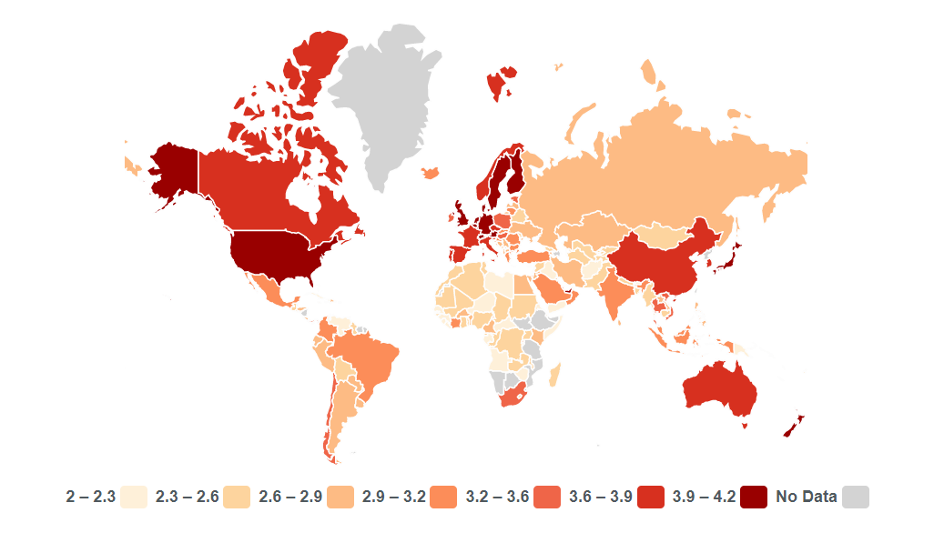
The importance of trade facilitation
Transport and other NTMs in Africa are extremely high when compared to other regions* and when compared to tariffs:
  The unit costs of road transport are 40–100% higher in Africa than in Southeast Asia (Rizet and Gwet, 1998)
  In landlocked countries, estimates suggest the costs are three to four times higher than in other developed countries (MacKellar et al., 2002).
  A 10% drop in transport costs could increase trade by 25% (Limao and Venables, 2001).
Word Bank Logistics Performance Index (LPI)
* https://www.theigc.org/reader/beyond-borders-making-transport-work-for-african-trade/key-message-1-high-cost-getting-goods-borders-ports-africa-restricting-continents-potential-gains-international-trade/
Notes:
Whereas tariff lib is a good start

Slide 20
Final thoughts
The AfCFTA has the potential to transform the continent and its trade relations with the rest of the world
AfCFTA trading arrangements are understandably complex; but efforts to eliminate tariffs and simplify rules will need to be accelerated in order generate meaningful gains
Much more attention needs to be given to reducing the real costs of doing business across the continent
  Trade facilitation
  Trade in services
  Movement of people
Notes:
Thanks again for the opportunity to share these thoughts and I look forward to learning more from the presentations and the discussion

